Slide 1

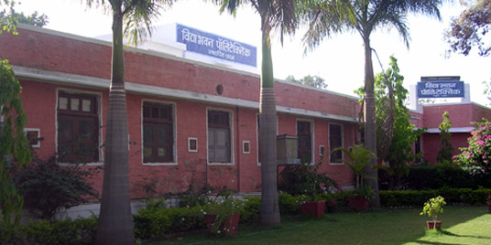

Welcome to Vidya Bhawan Polytechnic College, Udaipur
Vidya Bhawan Polytechnic College (Estd.1956) is an multi-dimensional technical education wing of Vidya Bhawan Society. Vidya Bhawan Polytechnic strives to produce socially sensitive and technically competent diploma and post diploma engineers. The Polytechnic also works with village community for technical skill improvement and livelihood enhancement of Rural Youth.

Slide 2
Summer Training Presentation on ASP.NET
www.shoppingkart.com
Training From:
Javonic Websoft Pvt. Ltd.
1st Floor Rachit Complex
Hiran Magri Sec-4
Udaipur (Raj.)
Submitted By:
Naresh Mali
3rd Year
Computer Science

Slide 3
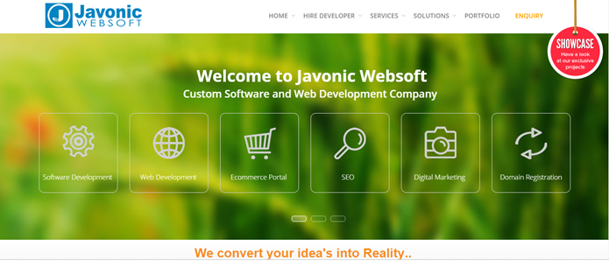
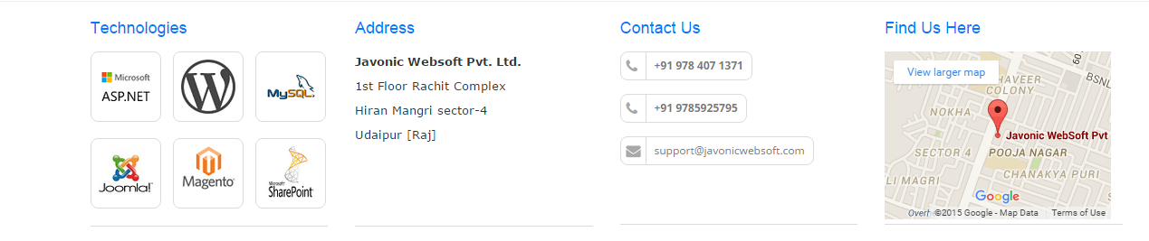
Javonic Websoft Pvt. Ltd.
Javonic learning is today a premium destination for academic excellence, having successful in IT education and training, live industrial training, project training and career oriented training.

Slide 4

TECHNOLOGIES
Web Design- Prepare for a career as a professional website designer crafting the look, layout, and organization of websites. The applications and concepts for this emphasis include HTML, Dynamic html, Photoshop, CSS, jquery, flash, Dreamweaver, style sheets, information architecture and graphical design concepts.
Web Development- The applications and technologies for this emphasis include web design techniques and also development programming tools like C#, SQL Server, Asp.Net, Asp.Net Ajax, XML, Crystal report, domain registration, web hosting and many other web development tools.

Slide 5

Software Development- The application and technologies for this emphasis include programming in VB, VB.NET, programming with ADO.Net, Custom control, Crystal report, Setup & development, client and server software , software testing, troubleshooting, SDLC.

Slide 6

Why Choose javonic
At Javonic Websoft, we have more than 20+ technical professionals including Project Managers, Programmers, Mobile app developers and other industry experts, exhaustively working, procuring and perfecting your way to success.

Slide 7
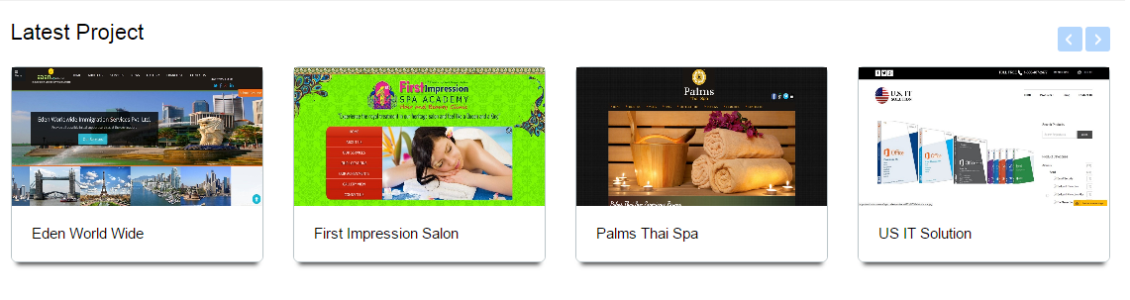
Projects on Recent Works

Slide 8
ASP.NET
Since 1995, Microsoft has been constantly working to shift its focus from windows-based platform to the internet As a result, Microsoft introduced ASP (Active Server Page) in November along with a new level of simplicity that made bit easy to understand and use.
.NET is a programming language. The main goal of .NET is to make it easier to develop application that run over the internet

Slide 9

Microsoft SQL server is a very popular and broadly situated general purpose database server supported on Windows server operating system.
Microsoft SQL server is a relational database management system developed by Microsoft. As a database, it is a software product whose primary function is to store and retrieve data.
Features
Adding empty files to the database.
Inserting new data into the existing files.
Retrieving data from the files.
Update data in the files.
Deleting data from the files.
Removing files from the database.

Slide 10
Front-End & Back-End Tool
Front-End Tool:-
.NET- In which toy can build, develop, create and debug your applications is called Front-End tool.
Back-End Tool:-
SOL- It is a powerful relational database management system that offer a large feature set.

Slide 11
Hardware and Software Requirements
Client Side Requirements:
Processor | Pentium (Dual core or i7 suggested)
RAM | 512MB (8 GB suggested)
Memory | 10GB (1 TB suggested for long term use)
Web Server | IIS (Internet Information services)
Server Side Requirements:
Processor | Pentium (Dual core or i7 suggested)
RAM | 512MB (8 GB suggested)
Memory | 10GB (1 TB suggested for long term use)
Web Server | Internet Explorer 7.0 or Higher

Slide 12
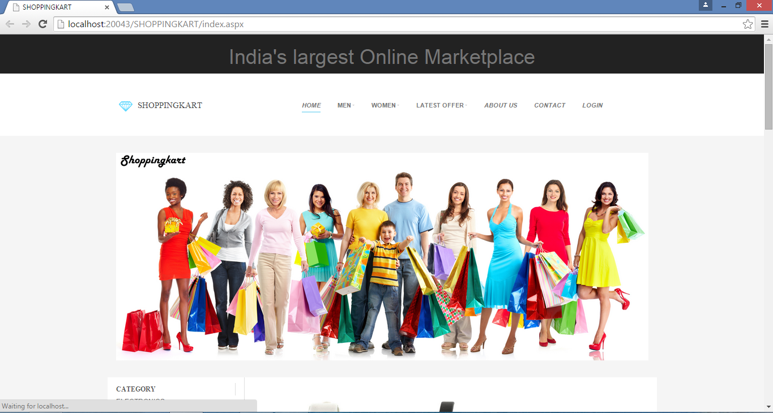
www.shoppingkart.com

Slide 13
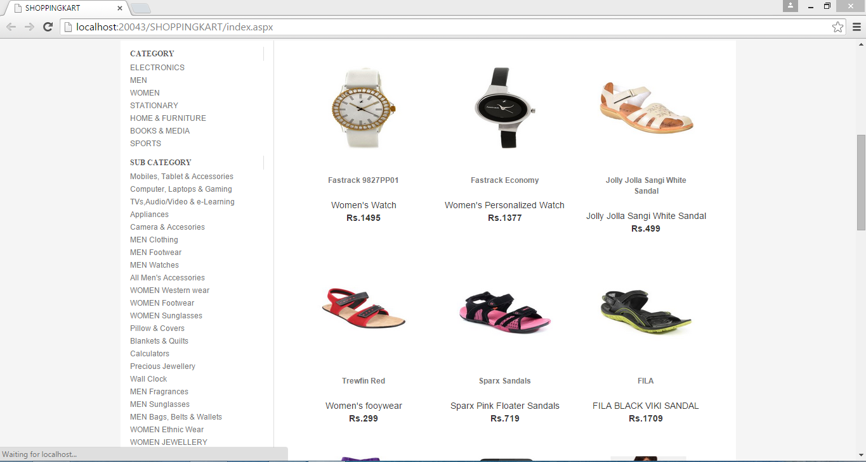
Home Page

Slide 14
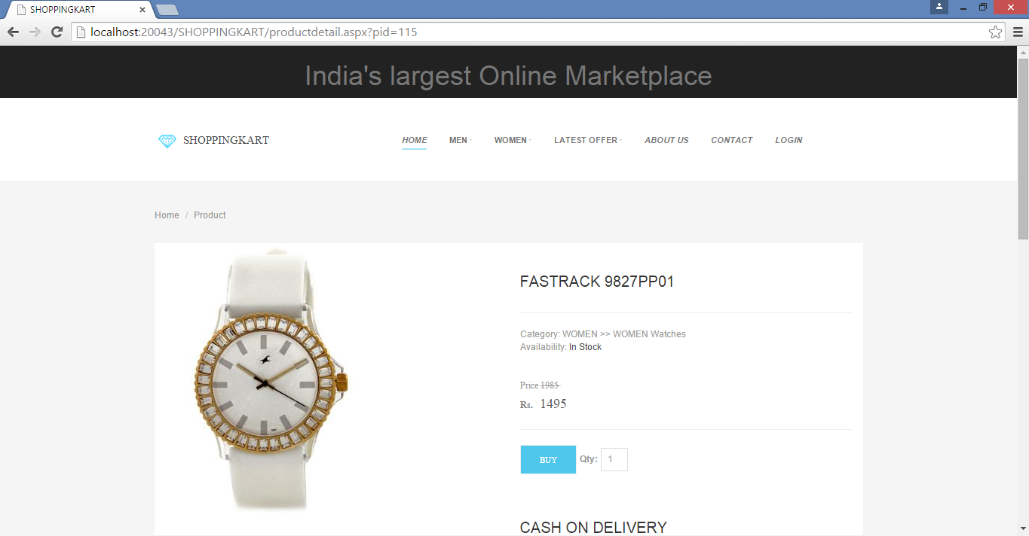
Product Detail Page

Slide 15
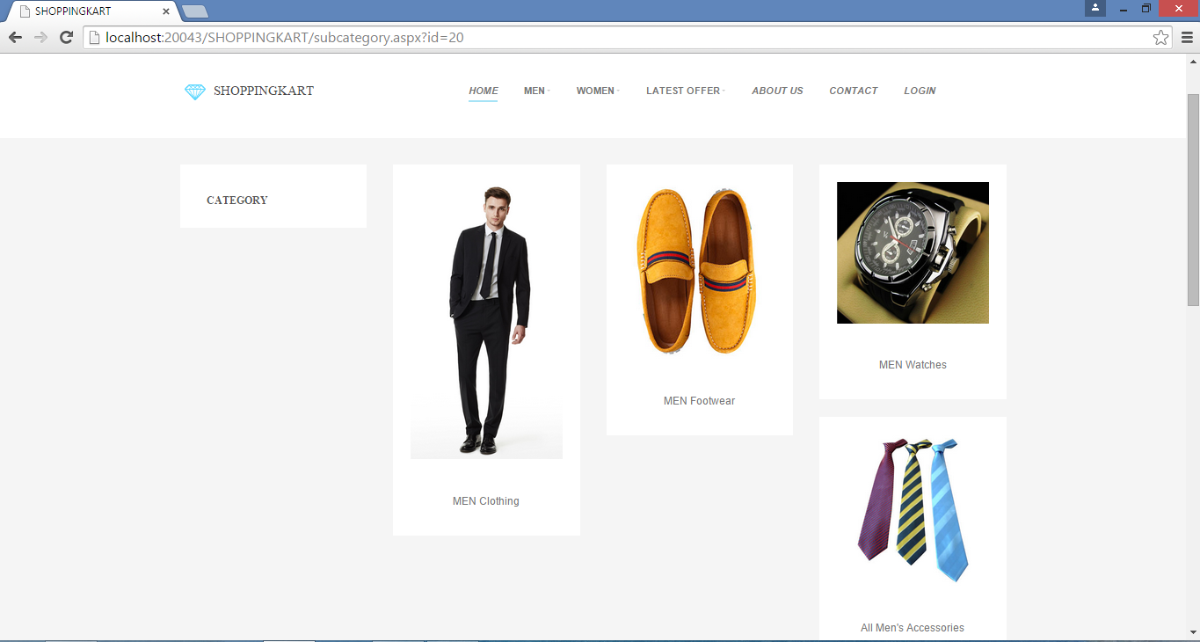
Men Products

Slide 16
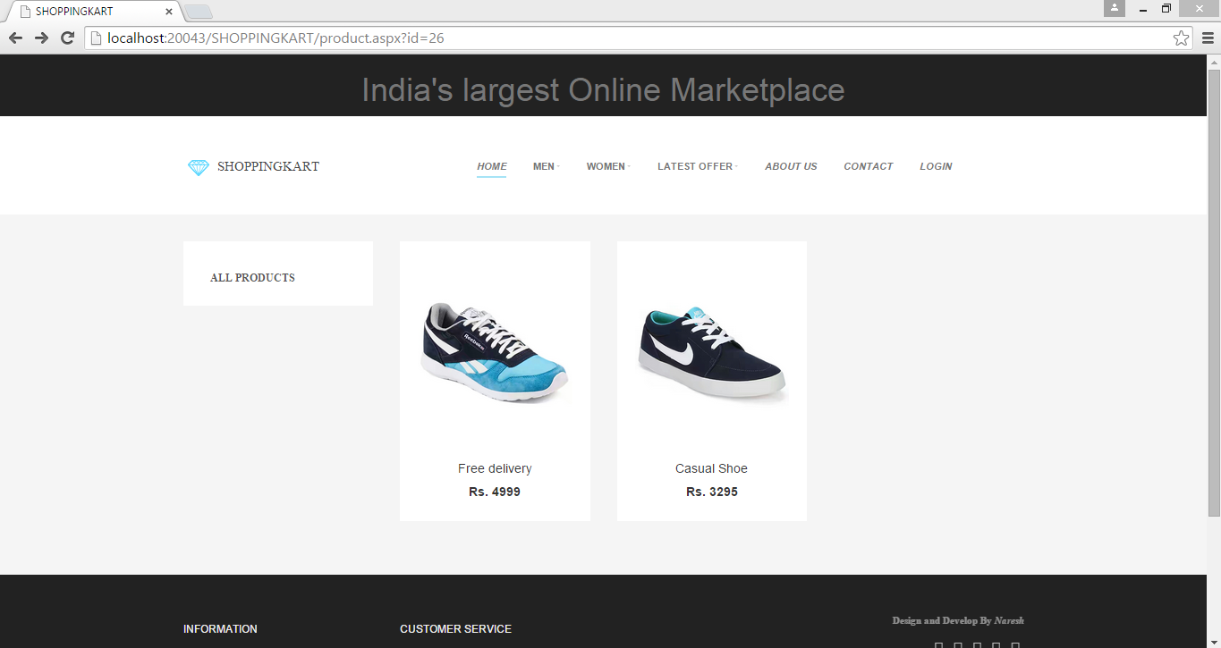
Men footwear

Slide 17
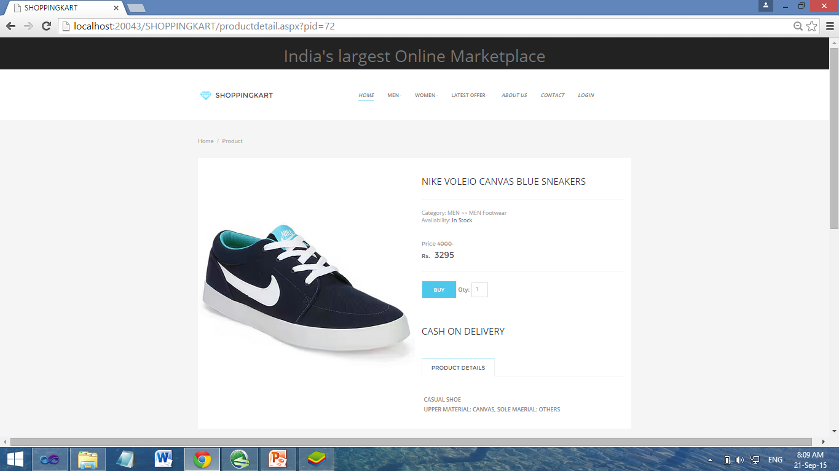
Product Detail

Slide 18
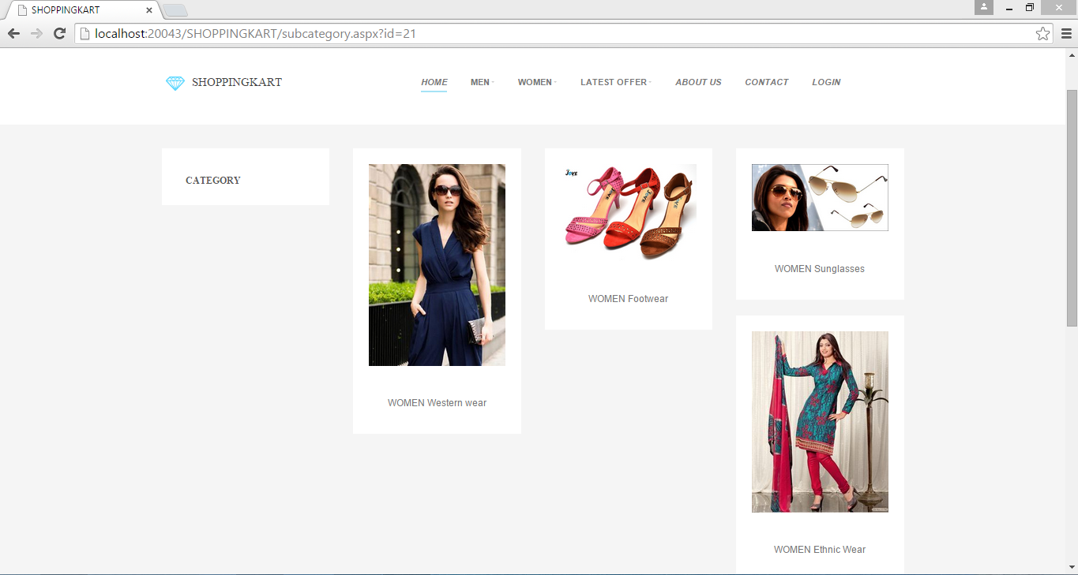
Women Products

Slide 19
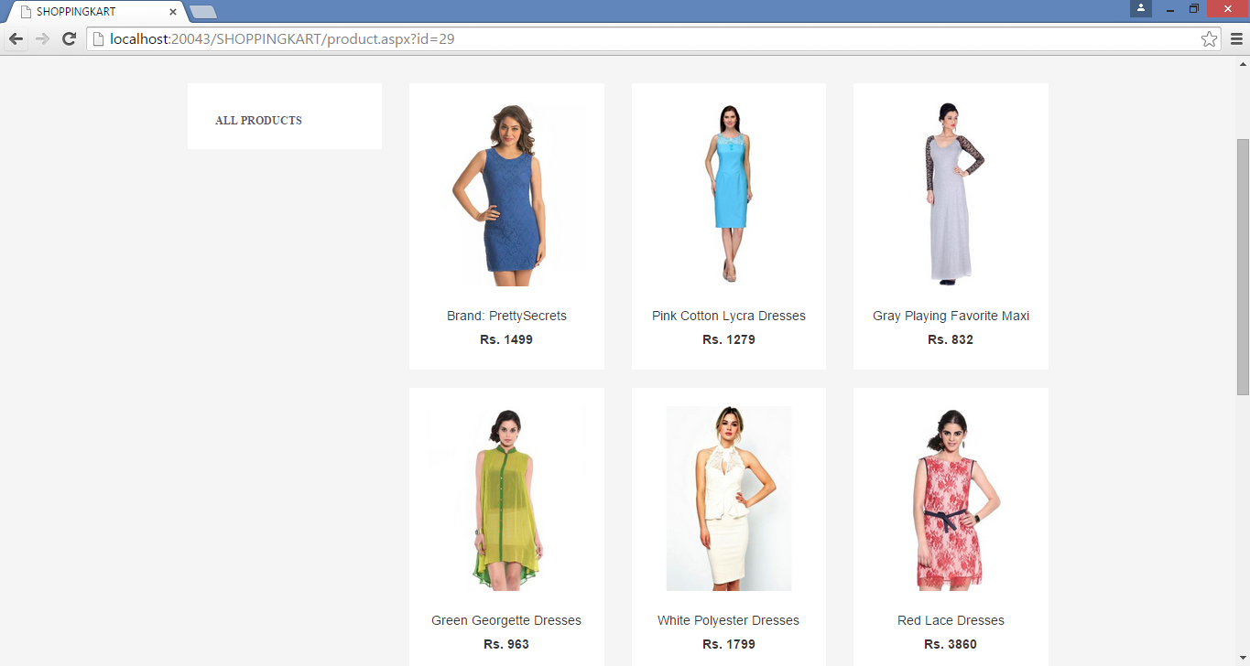
Women Western Wear

Slide 20
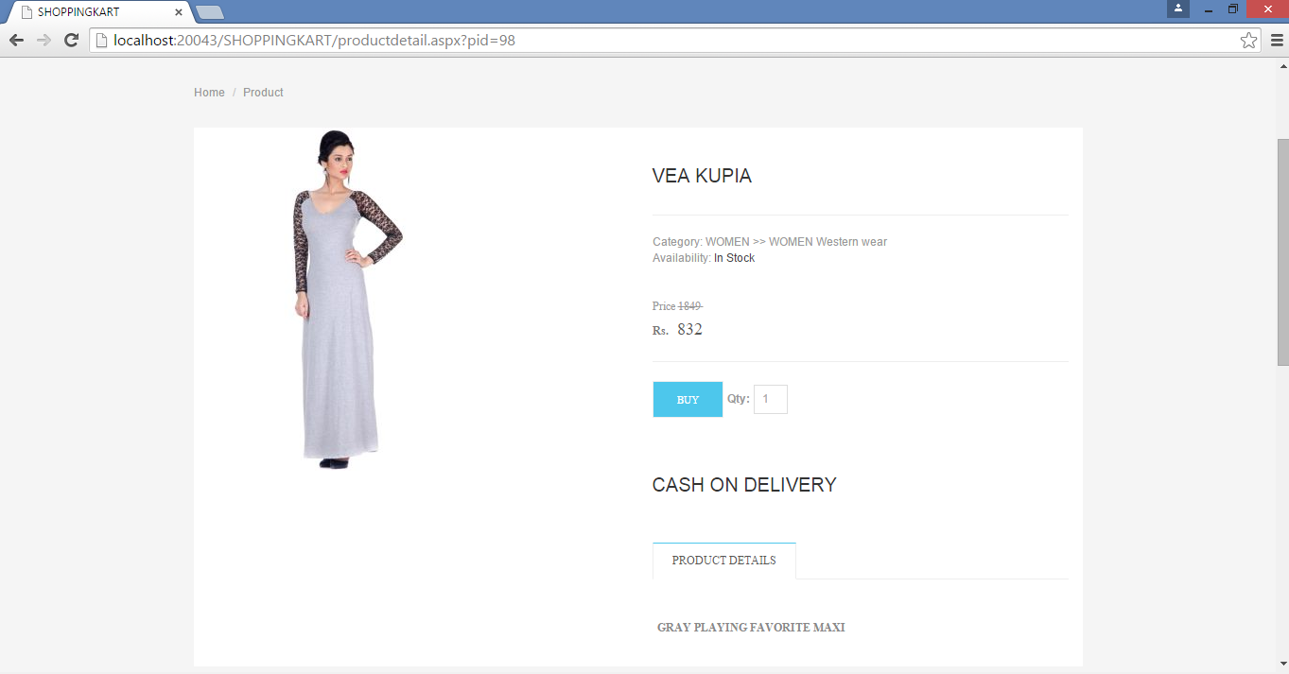
Women Product Detail

Slide 21
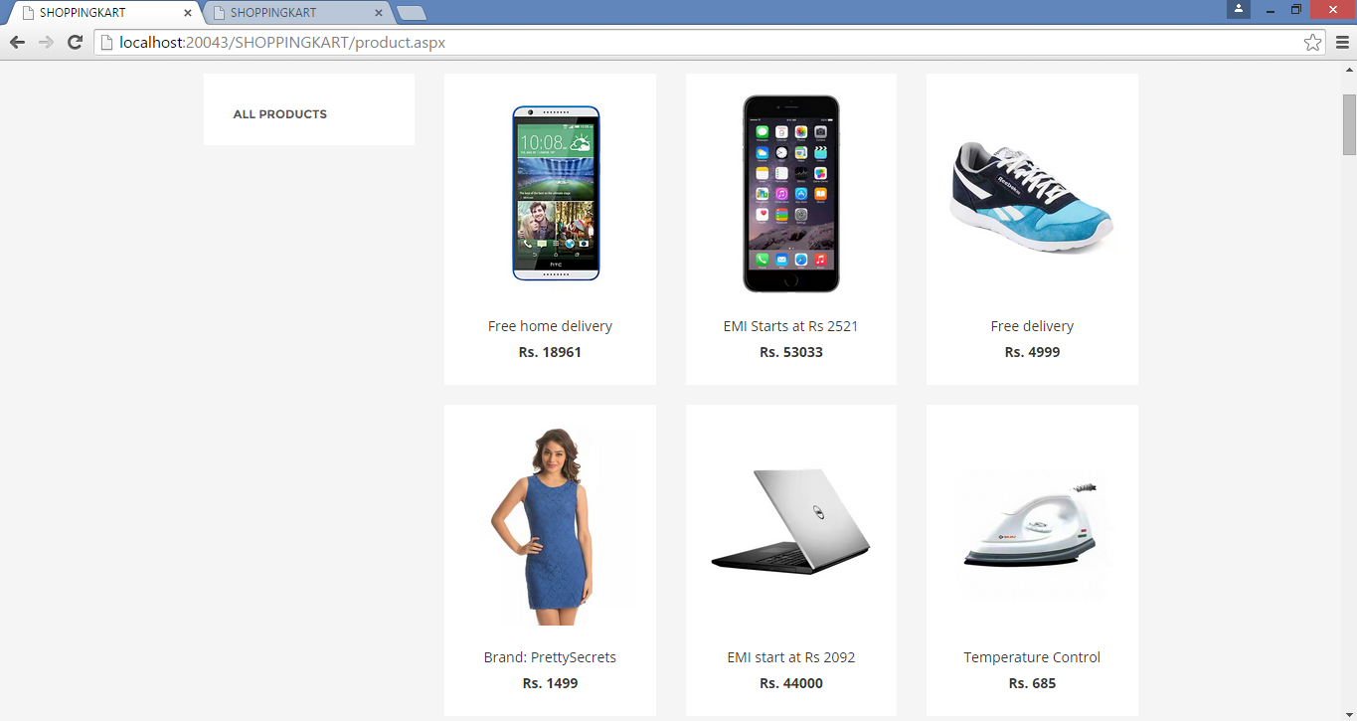
Latest Offers

Slide 22
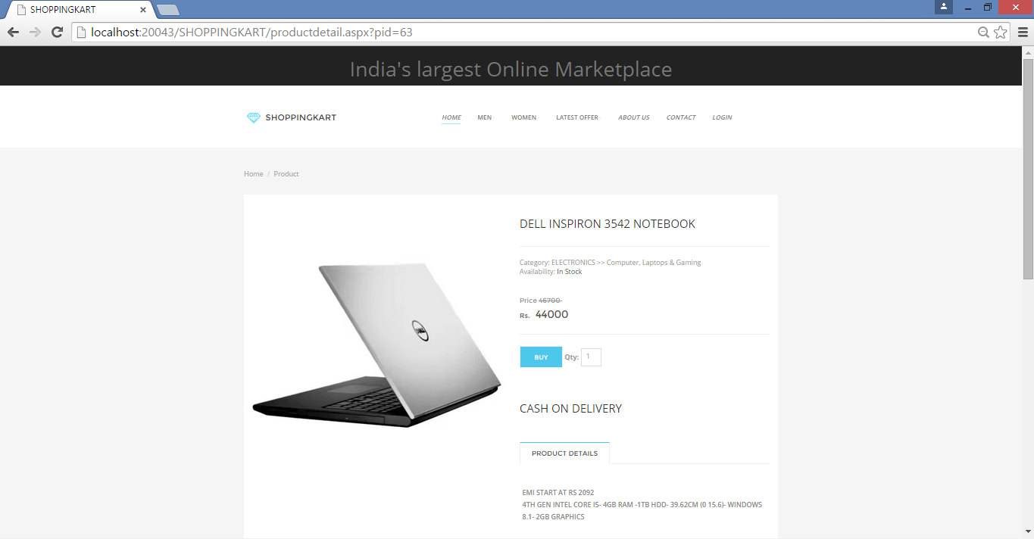
Product Detail

Slide 23
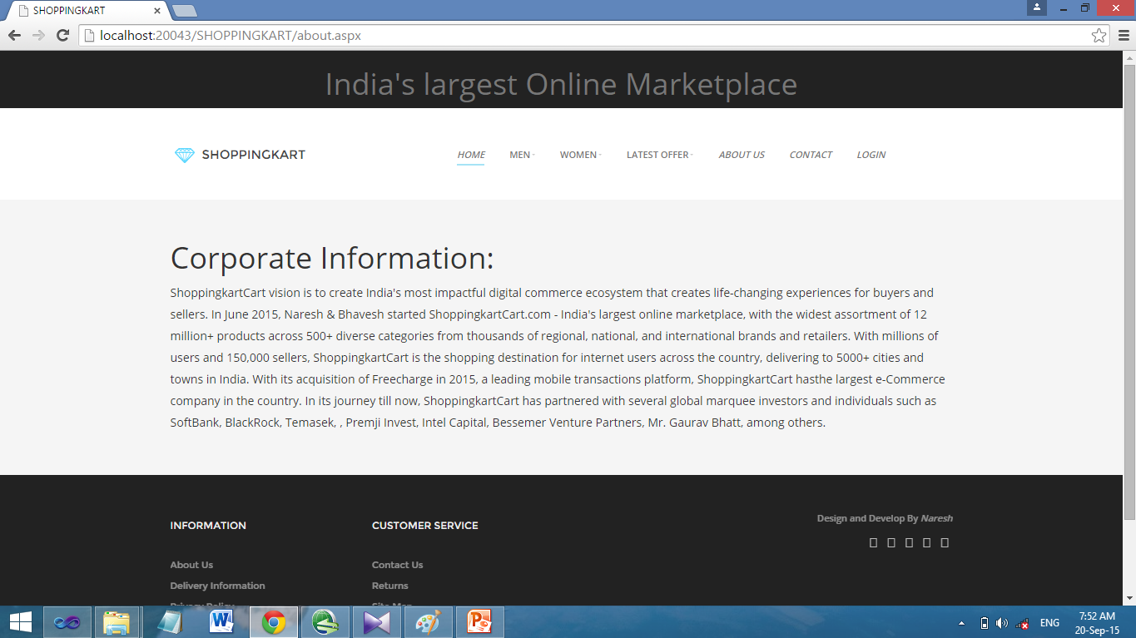
ABOUT US

Slide 24
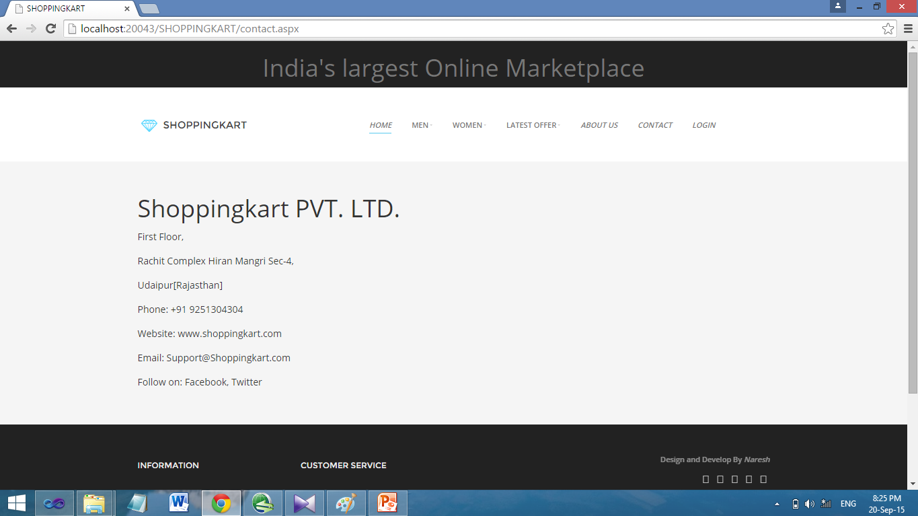
CONTACT US

Slide 25
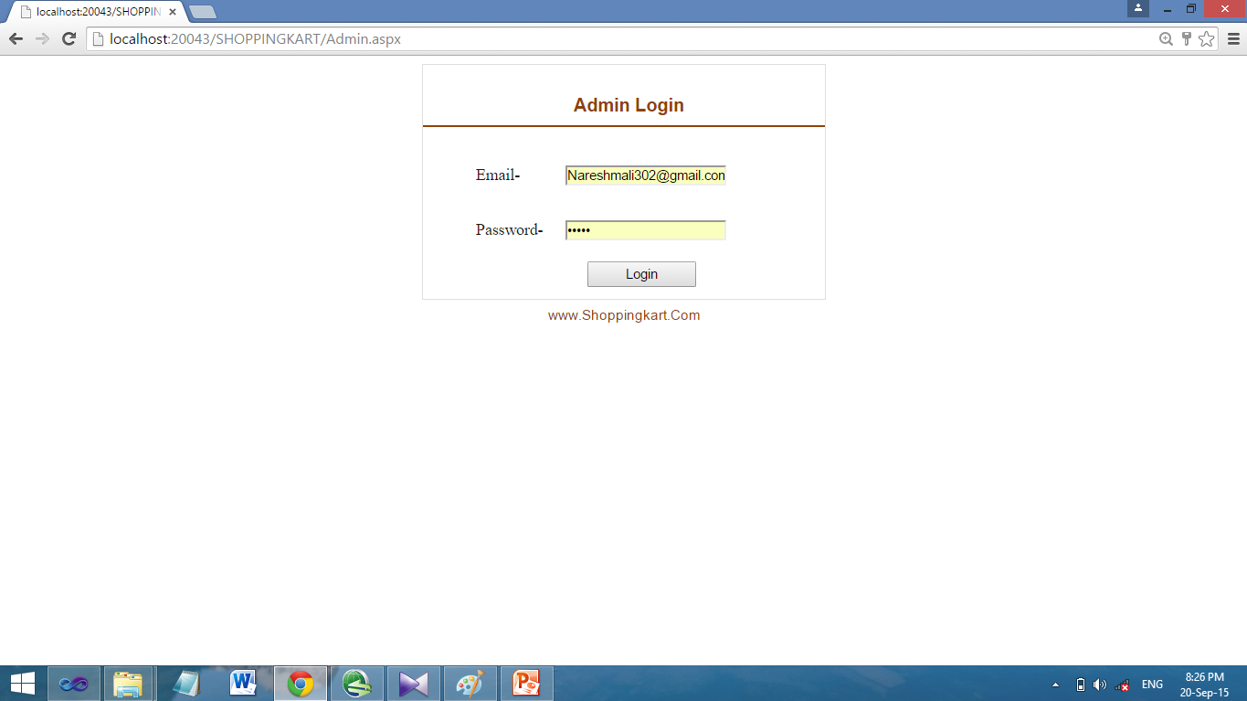
Admin Login

Slide 26
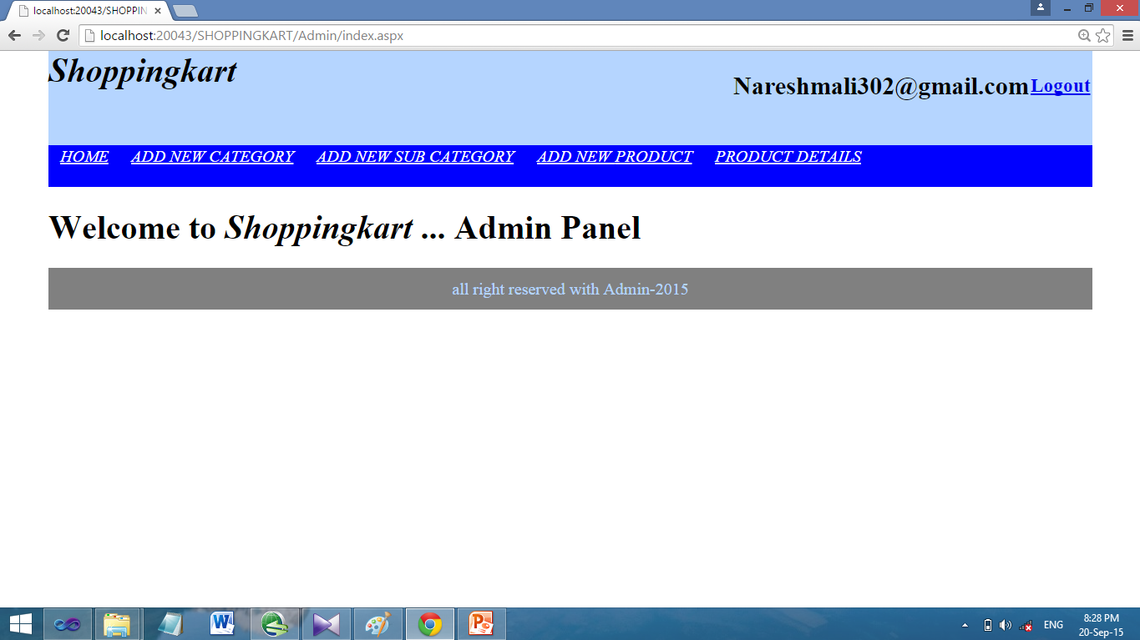
Welcome to Admin Panel

Slide 27
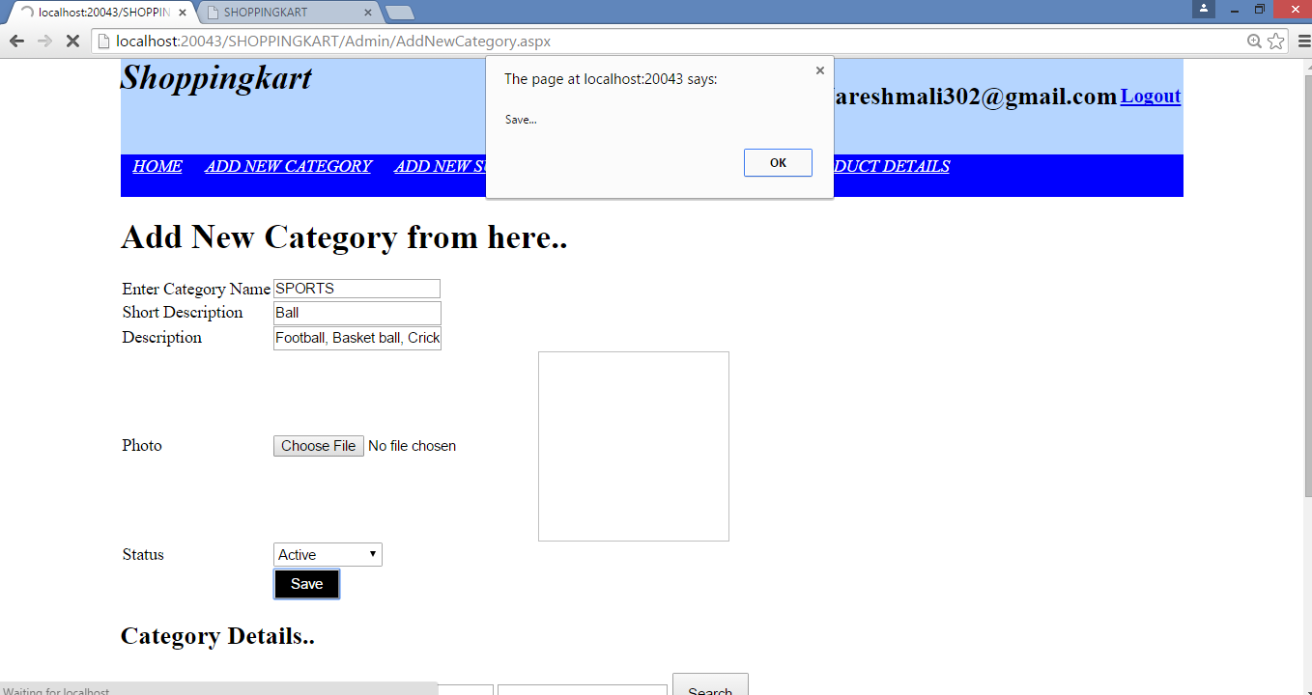
Add New Category

Slide 28
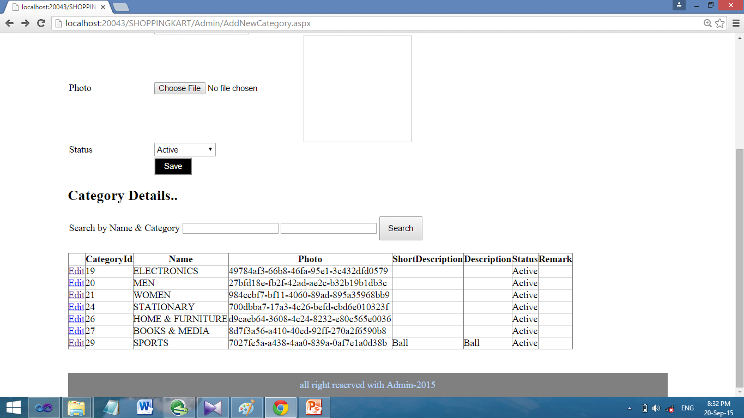
Category Detail

Slide 29
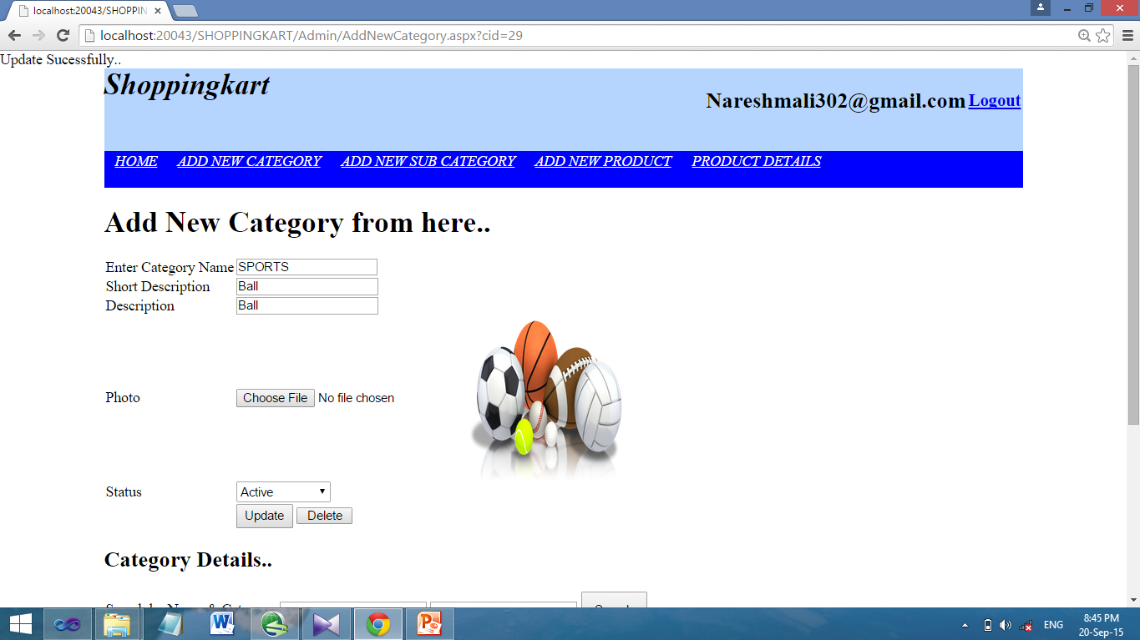
Update Category

Slide 30
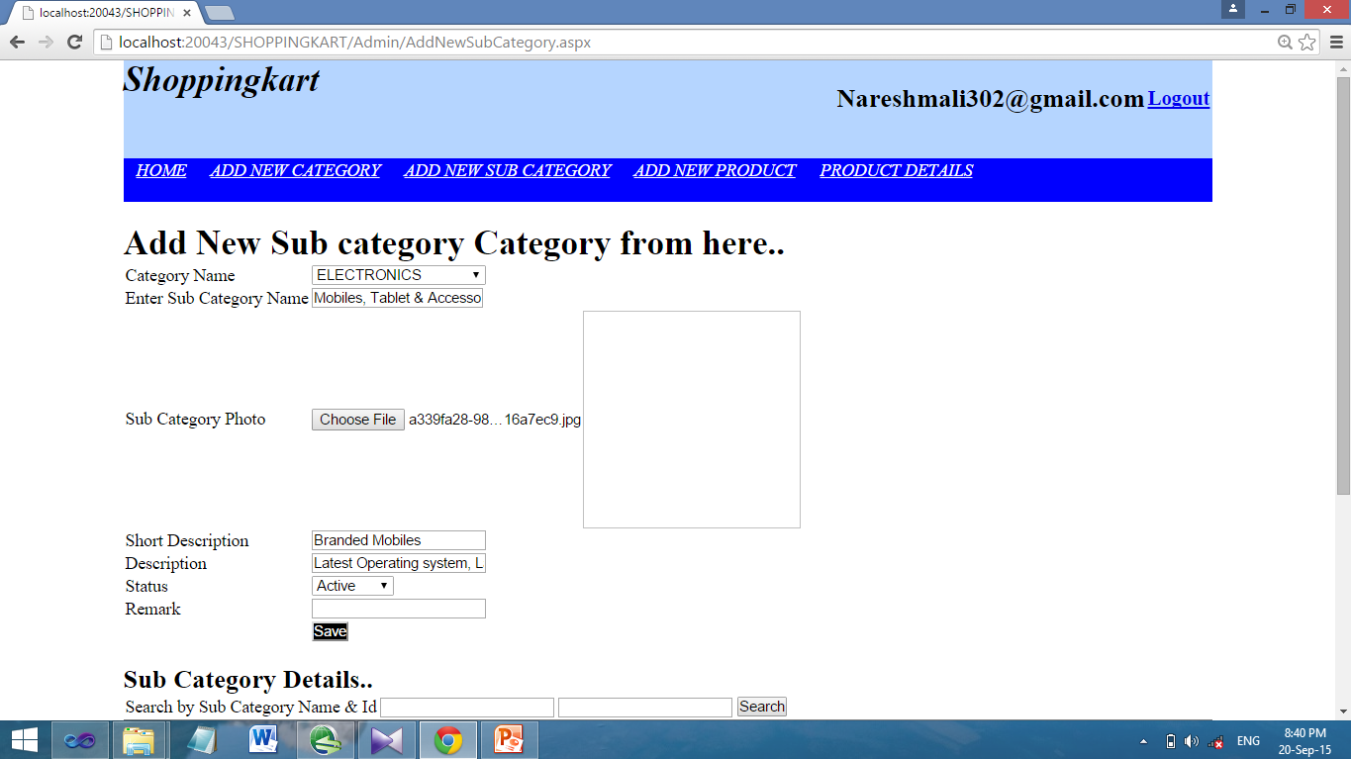
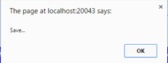
Add New Sub-Category

Slide 31
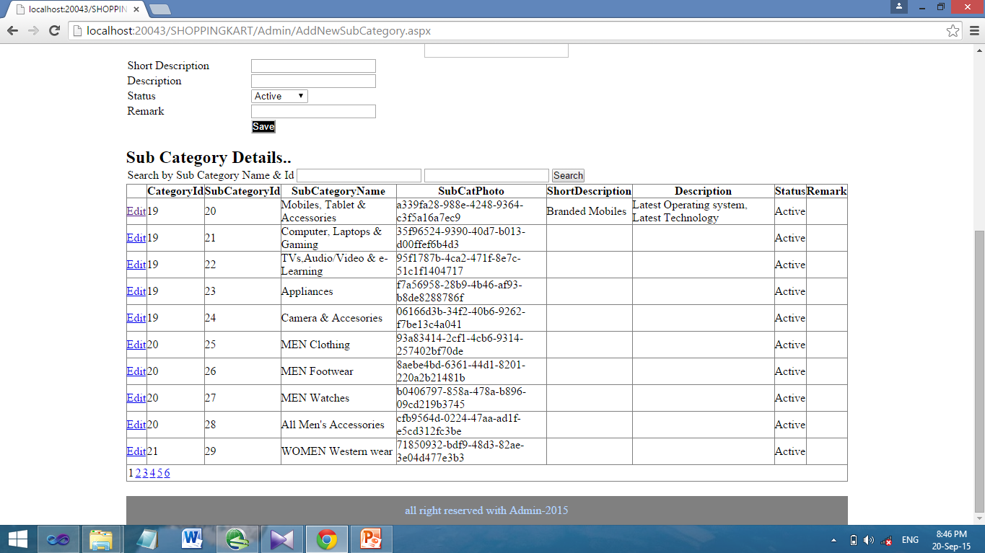
Sub-Category Detail

Slide 32
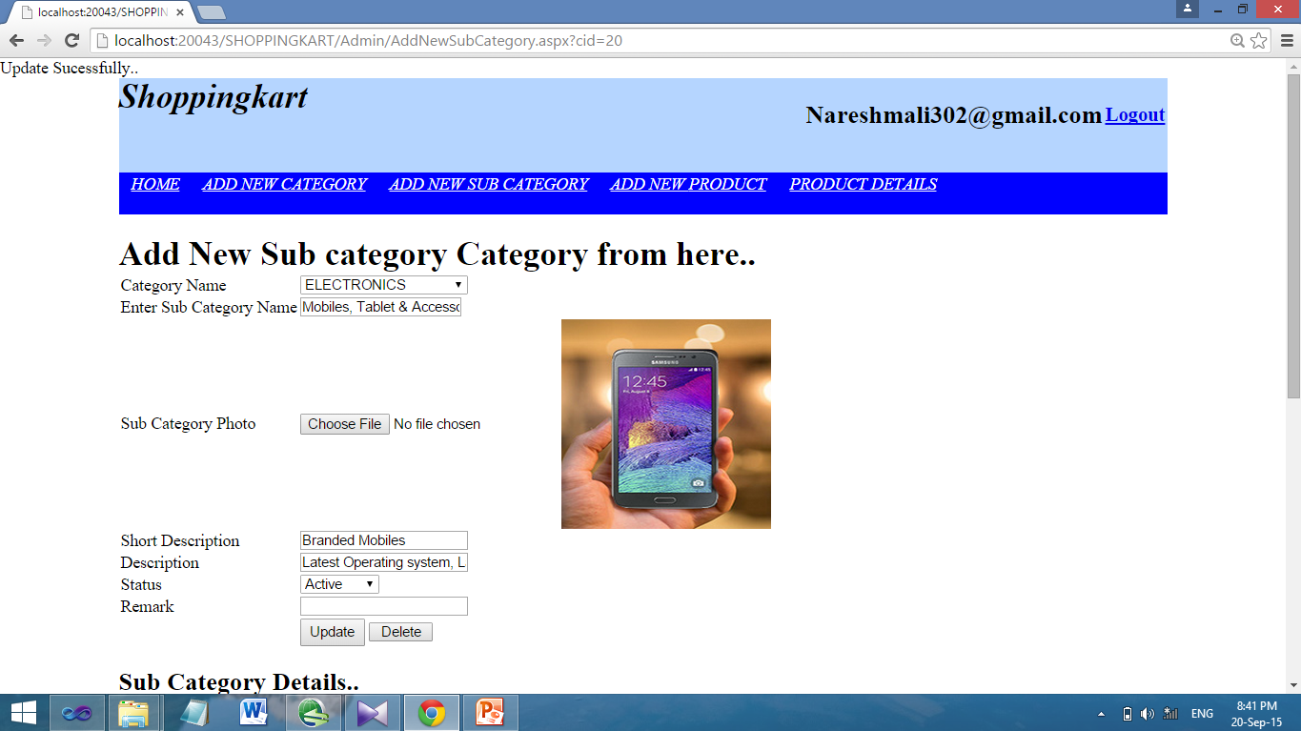
Update Sub-Category

Slide 33
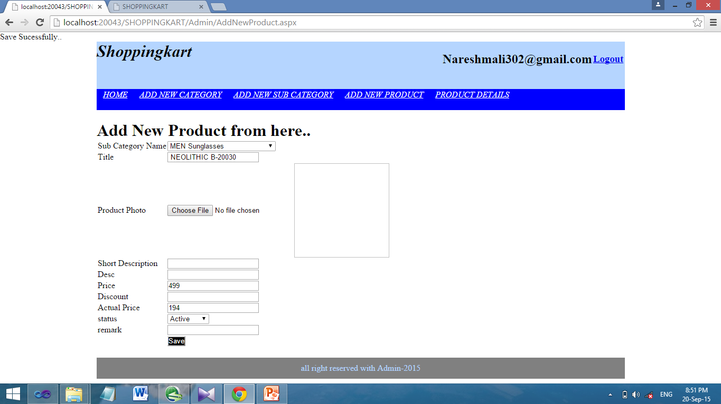
Add New Product

Slide 34
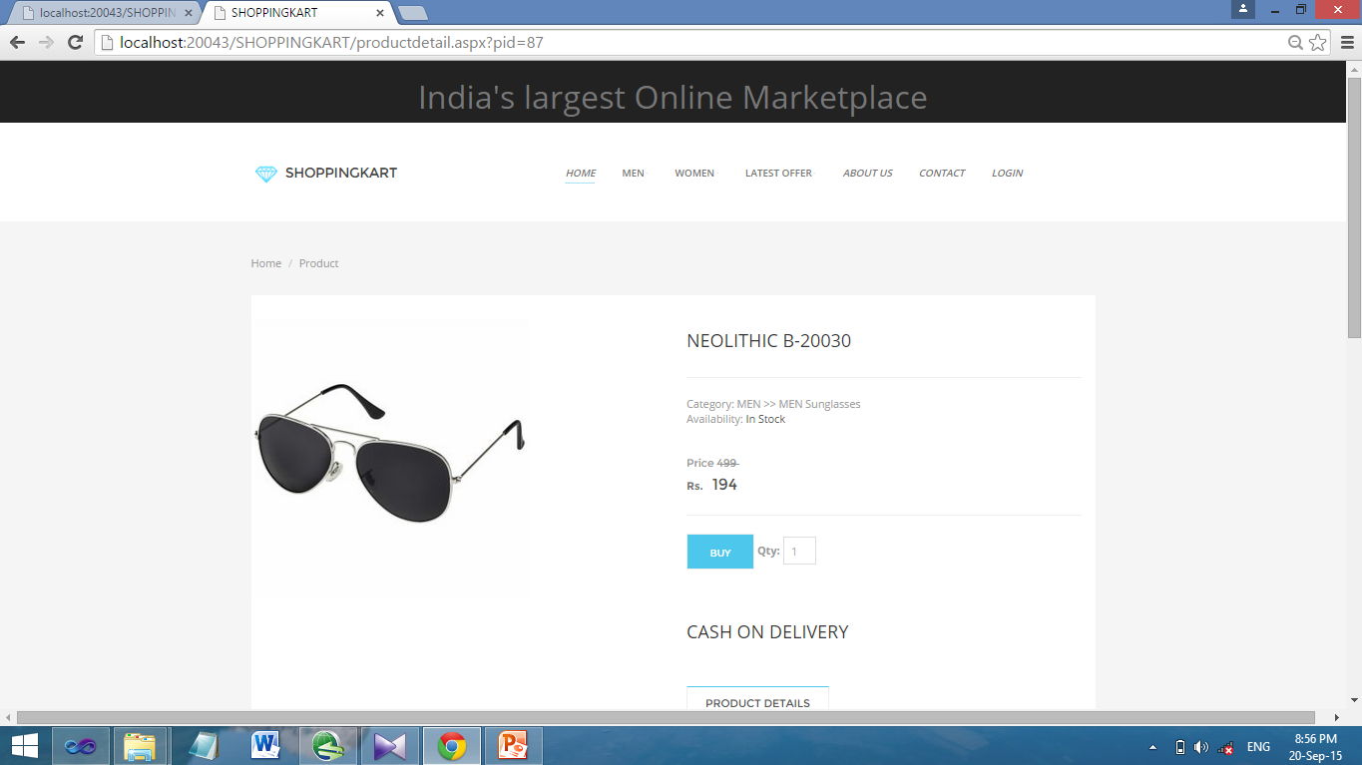
Add Successfully

Slide 35
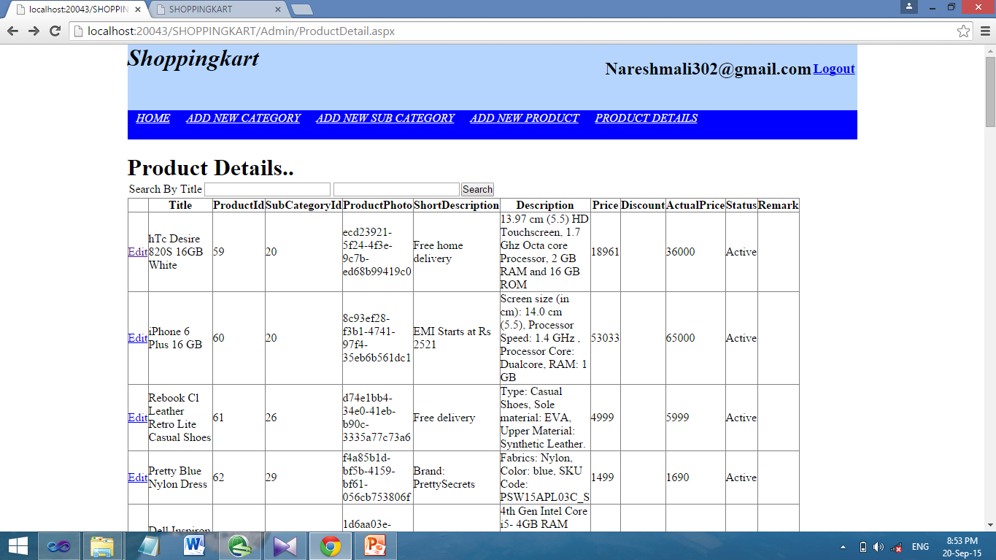
Product Detail

Slide 36
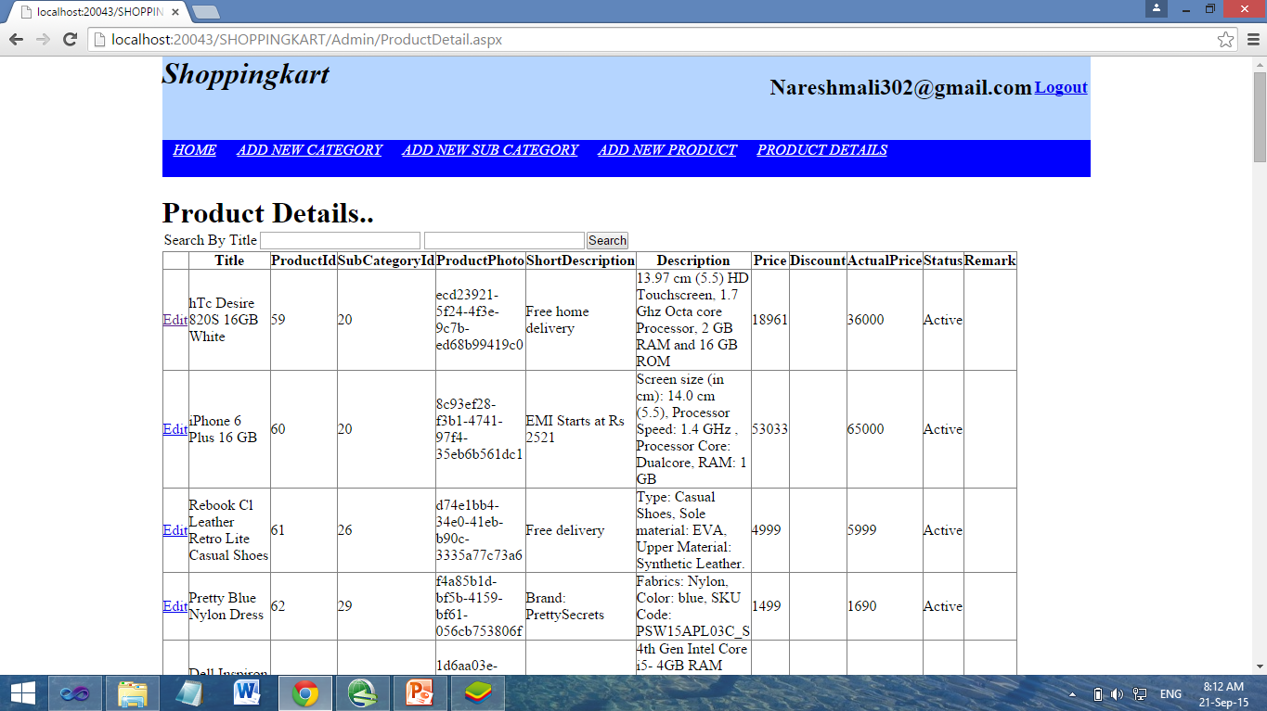
Check Product Detail & Logout

Slide 37
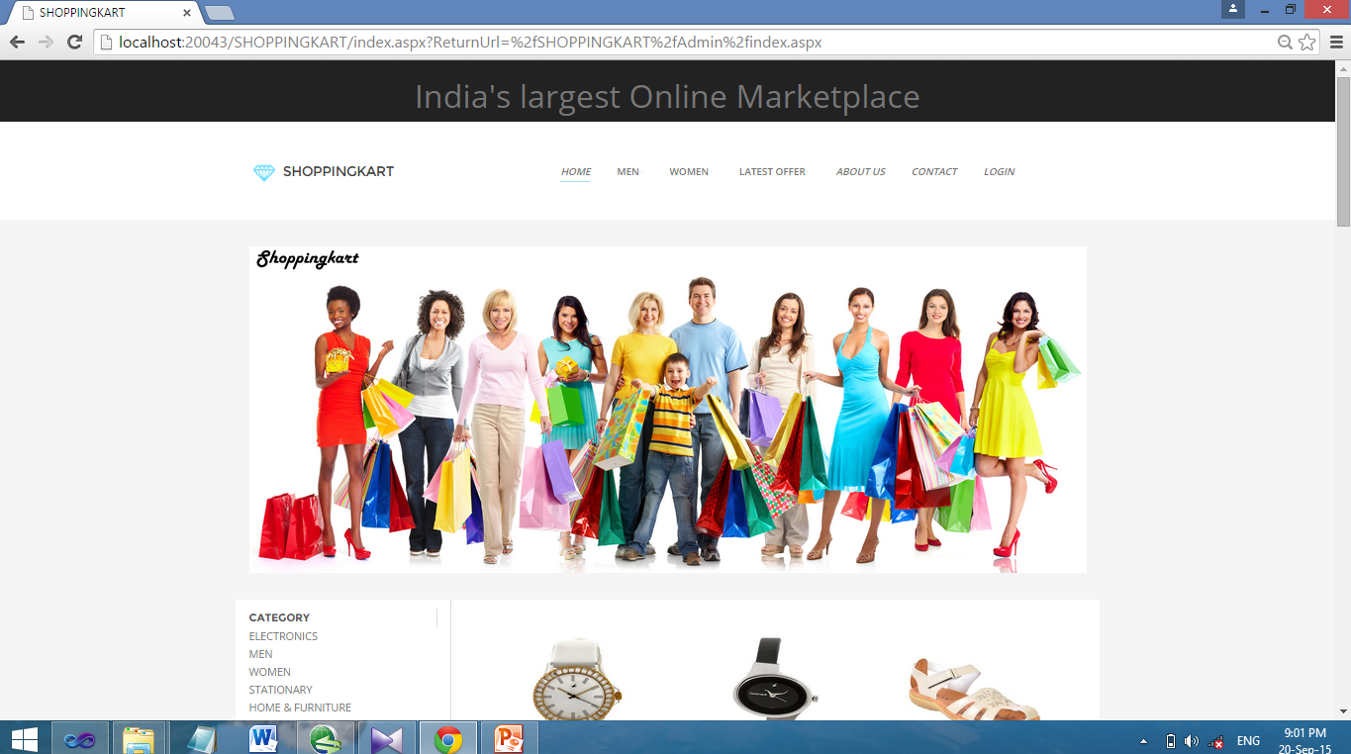
Logout Successful

Slide 38
Thank You

